Slide 2
Wheels in Motion: Preparing Your County for Transportation Funding Coming through the Bipartisan Infrastructure Law Dan Hinton Deputy Division Administrator Federal Highway Administration Georgia Division

Slide 3
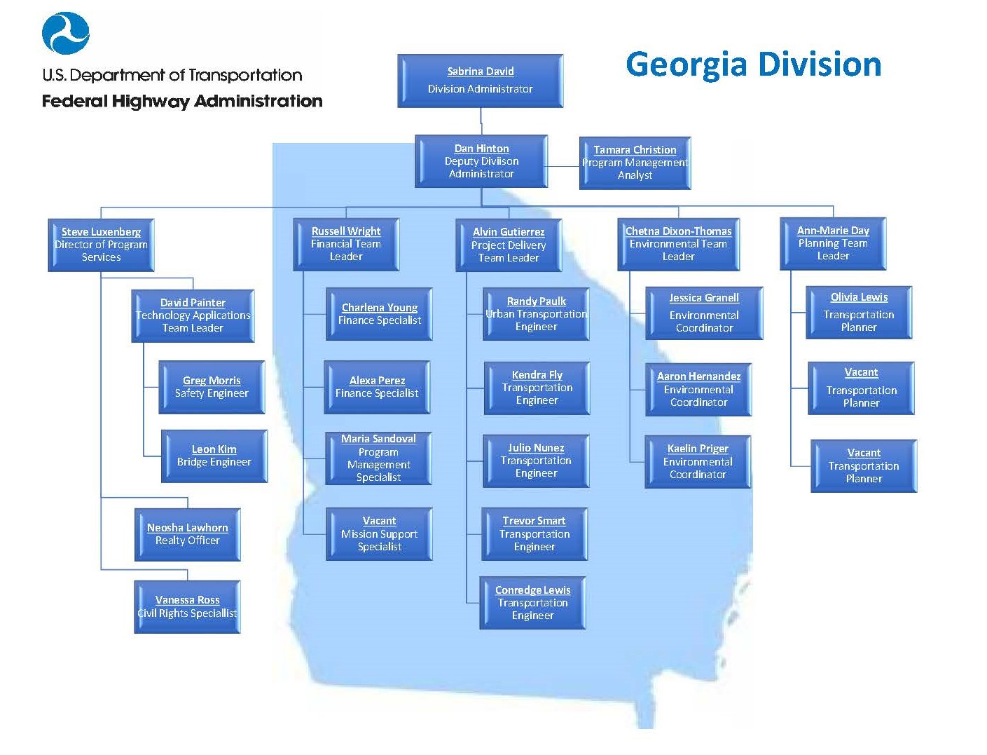

Slide 4
BIPARTISAN INFRASTRUCTURE LAW (BIL)*
*Also known as the “Infrastructure Investment and Jobs Act”

Slide 5
$303.5 B in Contract Authority from the HTF
BIL highway CA, apportioned vs. allocated
Five years of funding (FY 22-26)
+29% highway CA (avg. annual, FY 22-26) vs. current law (FY 21)
Mostly (90%) apportioned to States
90% apportioned (formula)
10% allocated

Slide 6
$47.3 B from the General Fund (GF) for “Highway Infrastructure Programs” (HIP)
BIL HIP advance appropriations, formula vs. discretionary
28% discretionary
Majority (72%) distributed by formula
All provided from the General Fund
28% discretionary
72% formula

Slide 8
Apportioned Programs

Slide 9
Discretionary Grants

Slide 10
Safe Streets and Roads for All
§24112
Purpose | Support local initiatives to prevent transportation-related death and serious injury on roads and streets (commonly referred to as “Vision Zero” or “Toward Zero Deaths” initiatives).
Funding | $5.0B (FY 22-26) in advance appropriations from the GF
Eligible entities | MPO Political subdivision of a State (e.g., local governments) Tribal government
Eligible projects | Comprehensive safety action plan (planning grant) Planning, design, and development activities for infrastructure projects and other strategies identified in a comprehensive safety action plan

Slide 11
Wildlife Crossings Pilot Program
§11123
Purpose | Support projects that seek to reduce the number of wildlife-vehicle collisions, and in carrying out that purpose, improve habitat connectivity
Funding | $350 M (FY 22-26) in Contract Authority from the HTF
Eligible entities | State highway agency (or equivalent) MPO Local government Regional transportation authority Special purpose district or public authority with a transportation function Indian Tribe Federal land management agency
Eligible projects | Projects to reduce wildlife-vehicle collisions

Slide 12
Promoting, Resilient Operations for Transformative, Efficient, and Cost-saving Transportation (PROTECT) Grants
§11405
Purpose | Planning, resilience improvements, community resilience and evacuation routes, and at-risk coastal infrastructure
Funding | $1.4 B (FY 22-26) in Contract Authority from the HTF
Eligible entities | State (or political subdivision of a State) MPO Local government Special purpose district or public authority with a transportation function Indian Tribe Federal land management agency (applying jointly with State(s)) Different eligibilities apply for at-risk coastal infrastructure grants
Eligible projects | Highway, transit, intercity passenger rail, and port facilities Resilience planning activities, including resilience improvement plans, evacuation planning and preparation, and capacity-building Construction activities (oriented toward resilience) Construction of (or improvement to) evacuation routes

Slide 13
Charging and Fueling Infrastructure
§11401
Purpose | Deploy electric vehicle (EV) charging and hydrogen/propane/natural gas fueling infrastructure along designated alternative fuel corridors and in communities
Funding | $2.5 B (FY 22-26) in Contract Authority from the HTF
Eligible entities | State or political subdivision of a State MPO Local government Special purpose district or public authority with a transportation function Indian Tribe Territory
Eligible projects | Acquisition and installation of publicly accessible EV charging or alternative fueling infrastructure Operating assistance (for the first 5 years after installation) Acquisition and installation of traffic control devices

Slide 14
Congestion Relief Program
§11404
Purpose | Advance innovative, integrated, and multimodal solutions to reduce congestion and the related economic and environmental costs in the most congested metropolitan areas with an urbanized area population of 1M+.
Funding | $250 M (FY 22-26) in Contract Authority from the HTF
Eligible entities | State MPO City or municipality
Eligible projects | Planning, design, implementation, and construction activities to achieve the program goals, including: deployment and operation of integrated congestion management systems, systems that implement or enforce HOV toll lanes or pricing strategies, or mobility services; and incentive programs that encourage carpooling, nonhighway travel during peak periods, or travel during nonpeak periods. Subject to certain requirements and approval by the Secretary, provides for tolling on the Interstate System as part of a project carried out with a grant under the program

Slide 15
Bridge Investment Program
§11118
Purpose | Improve bridge (and culvert) condition, safety, efficiency, and reliability
Funding | $12.5 B (FY 22-26), including— $3.3 B (FY 22-26) in Contract Authority from the HTF; and $9.2 B (FY 22-26) in advance appropriations from the GF
Eligible entities | State MPO (w/ pop. >200K) Local government Special purpose district or public authority with a transportation function Federal land management agency Tribal government
Eligible projects | Project to replace, rehabilitate, preserve or protect one or more bridges on the National Bridge Inventory Project to replace or rehabilitate culverts to improve flood control and improve habitat connectivity for aquatic species

Slide 16
Reconnecting Communities Pilot Program
§11509
Purpose | Restore community connectivity by removing, retrofitting, or mitigating highways or other transportation facilities that create barriers to community connectivity, including to mobility, access, or economic development
Funding | $1 B (FY 22-26), including— $500 M (FY 22-26) in Contract Authority from the HTF; and $500 M (FY 22-26) in advance appropriations from the GF
Eligible entities | Planning grants: State MPO Local government Tribal government Nonprofit organization Capital construction grants: Owner of an eligible facility (may partner with any of the eligible entities for a planning grant)
Eligible activities | Planning grants (ࣘࣘ≤$2M) Grants (≥$5M) for capital construction projects, including the removal and replacement of eligible facilities

Slide 17
Rural Surface Transportation Grants
§11132
Purpose | Improve and expand the surface transportation infrastructure in rural areas to increase connectivity, improve the safety and reliability of the movement of people and freight, and generate regional economic growth and improve quality of life.
Funding | $2 B (FY 22-26) in Contract Authority from the HTF
Eligible entities | State Regional transportation planning organization (RTPO) Local government Tribal government
Eligible projects | Highway, bridge, or tunnel projects eligible under NHPP, STBG or the Tribal Transportation Program Highway freight project eligible under NHFP Highway safety improvement project Project on a publicly-owned highway or bridge improving access to certain facilities that support the economy of a rural area Integrated mobility management system, transportation demand management system, or on-demand mobility services

Slide 18
National Infrastructure Project Assistance Program (“Mega-projects”)
§21201
Purpose | Provide funding through single-year or multiyear grant agreements for eligible surface transportation projects
Funding | $5 B (FY 22-26) in advance appropriations from the GF
Eligible entities | State MPO Local government Special purpose district or public authority with transportation function Tribal governments Partnership between Amtrak and one or more other eligible entities
Eligible projects | Highway/bridge projects on National Multimodal Freight Network, NHFN, or NHS Freight intermodal or freight rail projects that provide a public benefit Railway-highway grade separation or elimination projects Intercity passenger rail projects Certain public transportation projects

Slide 19
Local and Regional Project Assistance Program*
§21202
Purpose | Projects with a significant local or regional impact that improve transportation infrastructure
Funding | $7.5 B (FY 22-26) in advance appropriations from the GF
Eligible entities | State (and DC) Territory Local government Public agency or publicly chartered authorities established by one or more States Special purpose district or public authority with transportation function Federally-recognized Indian Tribe Transit agency
Eligible projects | Highway/bridge projects eligible under title 23 Public transportation projects Passenger or freight rail projects Port infrastructure investments Surface transportation components of an airport Projects for investment in surface transportation facilities on Tribal land Projects to replace or rehabilitate a culvert or certain projects to prevent stormwater runoff Any other surface transportation projects considered necessary to advance program goals
* Codifies the existing Rebuilding American Infrastructure with Sustainability and Equity (RAISE) program previously established through appropriations acts (and formerly known as TIGER and BUILD).

Slide 20
INFRA Program
§11110
Purpose | Multimodal freight and highway projects of national or regional significance
Funding | $8 B (FY 22-26), including: $4.8 B in Contract Authority from the HTF; and $3.2 B from the GF
Eligible entities | A State or a group of States MPO > 200,000 Local government or a group of local governments A political subdivision of a State or local government A special purpose district or public authority with a transportation function A Federal land management agency that applies jointly with a State or States A Tribal government or a consortium of Tribal governments A multistate corridor organization A multistate or multijurisdictional group of entities
Eligible projects | Projects that improve safety, generate economic benefits, reduce congestion, enhance resiliency, and hold the greatest promise to eliminate freight bottlenecks and improve critical freight movements; A highway, bridge, or freight project on the NMFN; Marine highway projects connected to NHFN and likely to reduce on-road emissions; Wildlife crossing projects; and Surface transportation projects within the boundaries of or connected to an international border crossing area

Slide 21
NATIONAL ROADWAY SAFETY STRATEGY

Slide 22
More than 370,000 people died in transportation incidents over the last decade (2011-2020) in the United States. More than 350,000 of them died on our roads.

Slide 23
Roadway fatalities and the fatality rate declined consistently for 30 years, but progress has stalled over the last decade and went in the wrong direction in 2020.
38,680 people died on America’s roads in 2020

Slide 24
U.S. DOT Vision for Roadway Safety
We must strive for zero roadway fatalities
Zero is the only acceptable number
Committed to taking substantial, comprehensive action to significantly reduce serious and fatal injuries
We will not reach this goal acting alone
Reaching zero will require a significant cultural shift that treats roadway deaths as unacceptable and preventable.

Slide 25
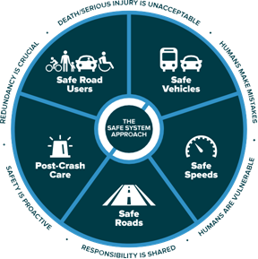

Slide 26
For more information
www.fhwa.dot.gov/bipartisan-infrastructure-law/
safety.fhwa.dot.gov/zerodeaths/zero_deaths_vision.cfm
Dan Hinton
Deputy Division Administrator
FHWA – Georgia Division
404-562-3635
Daniel.Hinton@dot.gov

